Slide 1
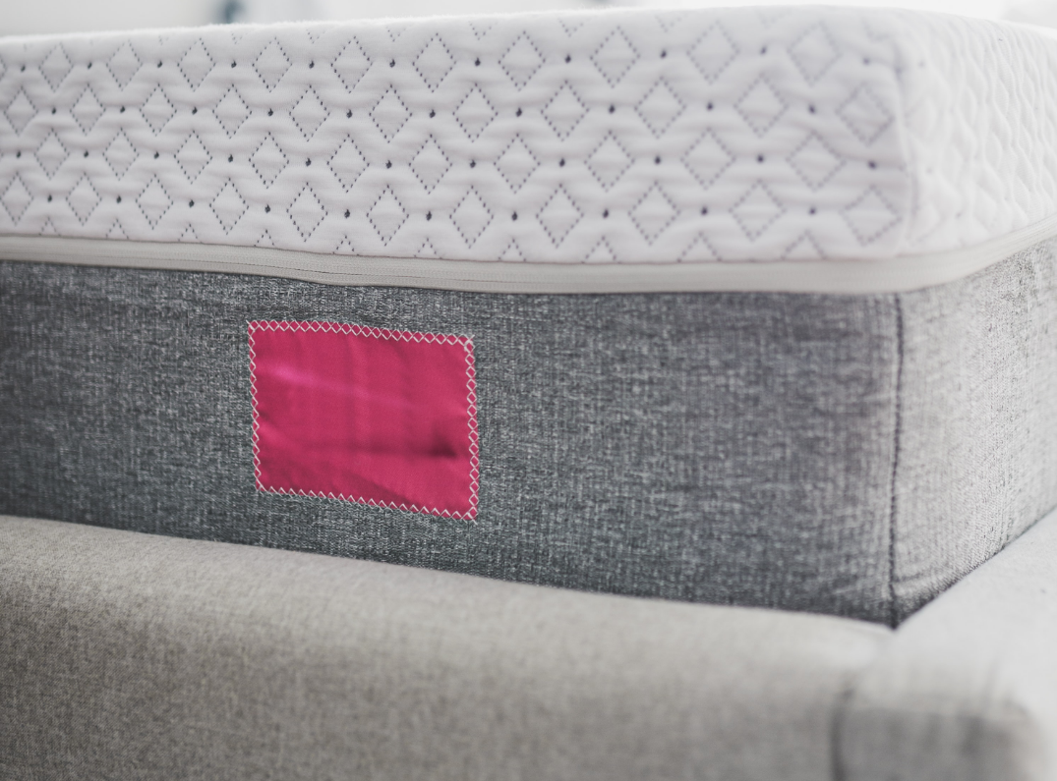
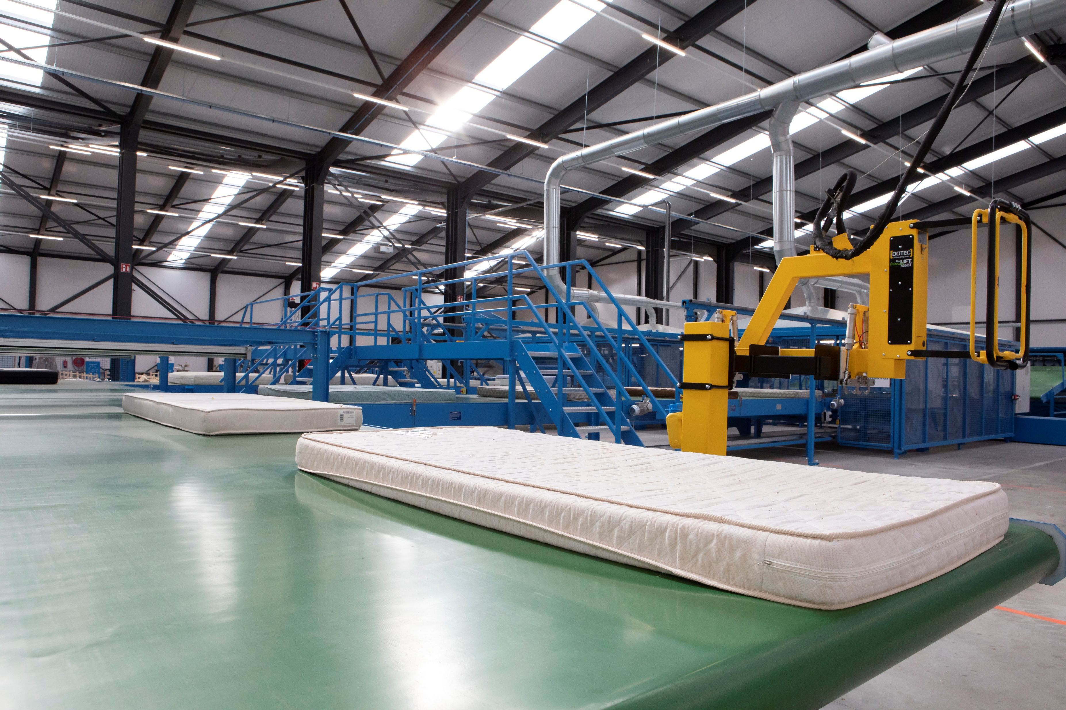
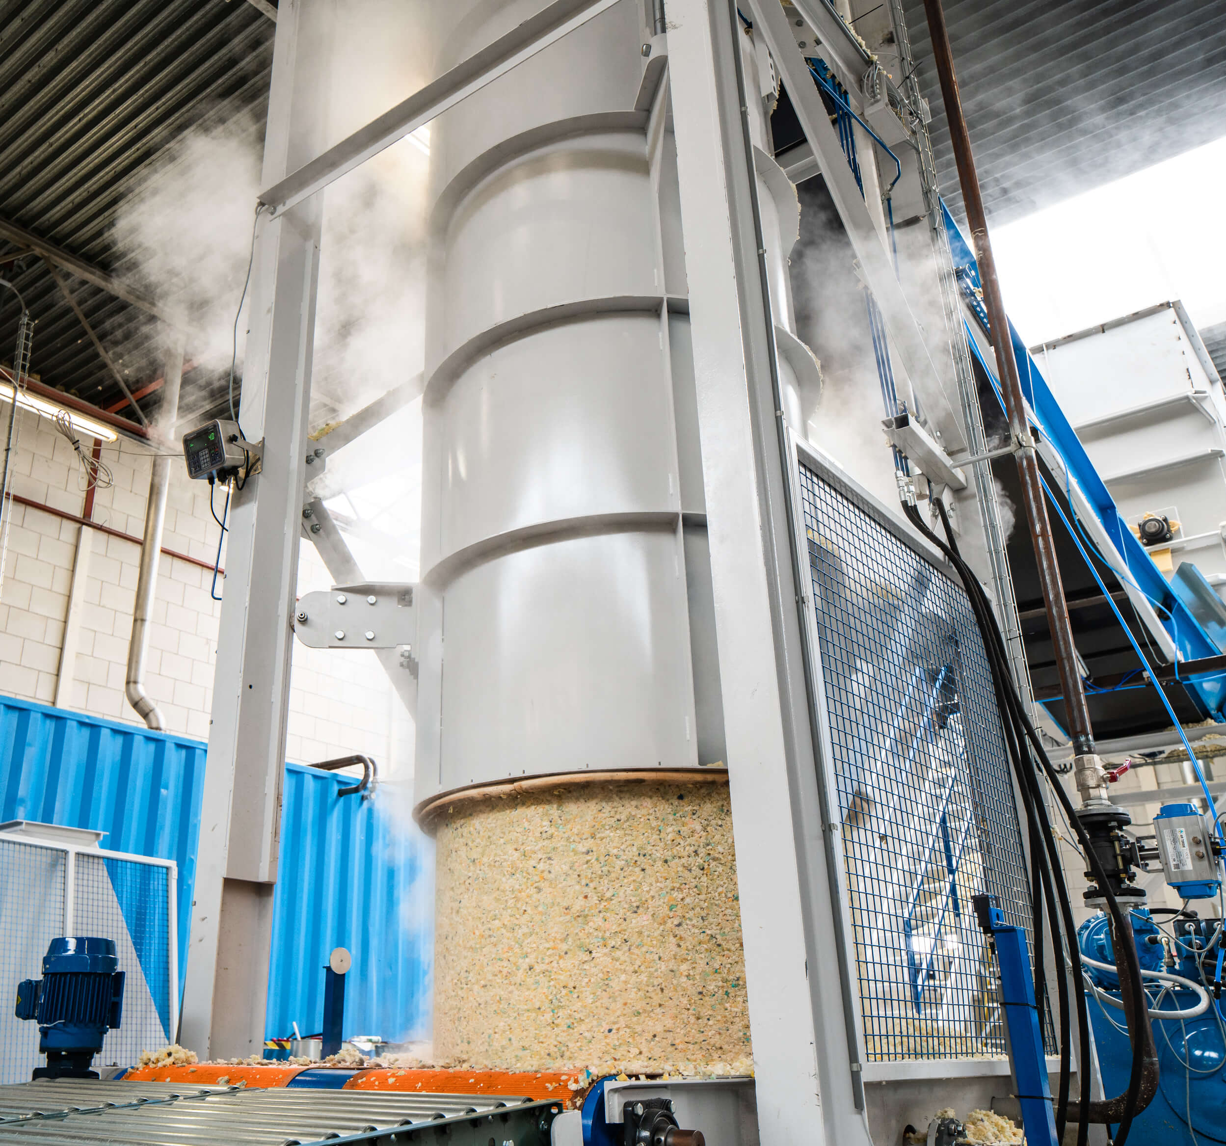
Organise for growth
Revised organization structure
retourmatras
confidential
RetourMatras Supervisory Board
7 February 2023

Slide 2
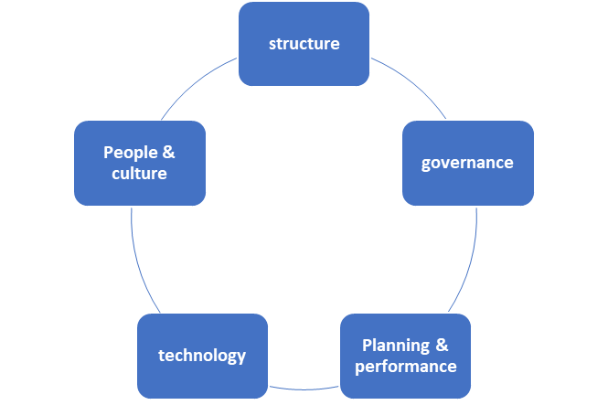
ORGANIZE 4 GROWTH
Ten years of entrepreneurship
RetourMatras and TfR started as entrepreneurial ventures 10 years ago. Guided by a vision to create positive impact both entities have grown into a medium-sized mattress recycling business. Success came from entrepreneurial mindsets and persistent hard work, sometimes swimming against the tide.
A decade of growth ahead
The decade ahead will be full of growth opportunities. The markets for mattress recycling and rejuvenation will develop through governments implementing adequate legislation and businesses delivering on sustainability commitments. The strategic plan 2028 describes the ambition in the years to come.
Organize 4 growth
To achieve the growth ambitions, the RetourMatras organization needs strong foundations to build on. The organization review identified how the company should look like going forward. Drafting a clear organization structure has been identified #1 priority to address.
Based on the input of the RetourMatras leadership team, the supervisory board has concluded on the revised organization structure going forward, which is described in this document. We strive to have this revised organization structure “live” by April 2024.

Slide 3
PRINCIPLES ORGANISATION STRUCTURE
The revised organization should create a solid foundation for RetourMatras’ growth ambitions by addressing the key pain-points today. An organization structure is never perfect and not forever. Therefore, the SB will evaluate the effectiveness of this revised structure. We aim to have this basic structure in place for 18 – 24 months, but we are flexible to adapt it in case the organization or the external environment changes.
Painpoints today
Unclear reporting lines & accountabilities among leadership team positions. UK & BLX operate as independent units: Limited standardization Duplication of R&D investments No integrated approach to outgoing materials to global markets.
Principles revised organization structure
Create clarity on key positions’ roles & responsibilitiies and reporting lines. Develop one organisation with an integrated strategy for all business activities and all markets. Reap scale efficiencies through standardisation, focused R&D invesments and global accounts. Safeguarding entrepreneurship by decision making closest to customers and co-workers.

Slide 4
THE REVISED ORGANIZATION STRUCTURE
CEO
Finance director
* Role filled only if organization size demands it
COO*
MD BLX
MD UK
MD country xxx
MD Bus dev
Concept owner Rejuvenation
Concept owner Dismantling
Unit x
Unit x
Unit x
Unit x
Unit x
Unit x
Concept owner Raw materials
Note: The CEO & Finance director are permanent invitees to the Supervisory board meetings. The MDs are invited to SB meetings for relevant topics.

Slide 5
THE RATIONALE
Ownership and entrepreneurship through a regional structure
The RetourMatras’ core business activities (rejuvation & recycling) have a rather local customer base (national EPR scheme, municipalities or B2B customers). A first-level regional structure ensures that ownership and decision-making is kept close to the customer. The regional unit will have full P&L responsibility for deploying the RetourMatras business activities (rejuvenation, dismantling & raw materials production) within the agreed concept & standard.
Ensure standardisation through concept owners
We introduce the role of concept owners as a means to anchor the standardisation of business activities across the regions. The concept owner roles will initially be combined with MD functions. If the organisation grows in size or complexity, a COO role might take responsibility for the standardisation instead. Standardisation of the business activitis should lead to:
Consistent performance management and benchmarking across operating units.
Focused R&D investments that benefit RetourMatras’ overall strategy and are effective across operting units.
Lower CAPEX (standardisation of solutions, common supplier agreements) and maintenance costs (spare-parts & remote support by other units)
Cost-efficient scaling of business business activities to new markets, incl. licensing business model to others.
The concept owner does not operate in isolation but activley seeks inputs from the regional MDs and the operating units to come to a agreed standard that can be implemented. In case no agreement is reached, the decision is escalated to the CEO.

Slide 6
THE RATIONALE
Centralised approach to outgoing materials & expansion through BD function
The revised structure introduces a Business Development position to bring a focused commercial approach to global customers of outgoing materials (metals, repolyol, rebond, foamflakes & textiles). Next, this position takes global customers for dismantling and rejuvenation activities to launch business in new expansion markets. In addition to global account-management, the BD function initiates and nurtures business acitivities in new markets until the moment these are sufficiently mature to be a geograhic region on its own. Finally, the BD function is responsible for innovation that increase value of the outgoing materials (e.g. Textiles).
Centralised strategy & organisation development through CEO
The development on one integrated organisation, with different business acivities across different region is the key responsibility of the CEO position. We expect this role to ensure integration from a strategic perspecitve, but also build an effective management team and one high-performing organisation.
Clarity through reporting lines & competence profiles
For every leadership position, a competence profile will be formulated to ensure clarity on the accountabilities and responsibilities for every role. In addition, the revised structure defines the reporting lines within the leadership team, and from the management team to the supervisory board.

Slide 7
KEY LEADERSHIP ROLES
Position* | Accountability** | Key responsibilities**
CEO | Formulate and implement strategy to drive overall performance & development of the business. | Formulate long-term business strategy and business plans and ensure its implementation. Maintain effective relationships with shareholders & supervisory board. Implement the People agenda: (management) team development, succession planning & HR strategy Build one organisation identity and lead the company culture and values
Finance director | Secure the overall performance & development of the business. | Lead financial business planning and support MDs with formulating business cases. Ensure reliable and timely budgets, forecasts and reports of financial and operational results. Drive the agenda to secure long-term financial stability. Maintain effective relationships with shareholders & supervisory board.
Regional MD | Final P&L responsibility for business activities in the region. | Ensure optimal operations across all units in the region, within the agreed standard. Formulate and implement strategies to grow market-share in the region. Manage key clients & prospects. Lead the implementation of HR strategy in the region. Contribute to long-term strategy and annual business planning. Ensure reliable and timely budgets, forecasts and reports of the region’s financial and operational results
* Job titles might be adapted in the competence profiles.
** For Indicative purpose only. Accountabilities & responsibilities to be finalized in competence profiles

Slide 8
KEY LEADERSHIP ROLES
Position* | Accountability** | Key responsibilities*
MD business development | Ensure a profitable pipeline of customers (global accounts) and development of the business in line with long-term strategy. | Manage global accounts for outgoing materials (metals, repolyol) as well as incoming mattresses for rejuvenation, dismantling. Own the expansion agenda for mattress rejuvenation and mattress recycling within European markets. Formulate and implement strategies to maximize recycling-rate and commercial value-add for material streams.
Concept owner*** | Secure a standardised approach to all key business activities | Owns, develops and maintains standards for a business activity, including: Technology used Maintenance & equipment supplier(s) Ways of working Owns R&D project portfolio and prepares CAPEX investments. Goalsetting and benchmark performance across operational units on relevant KPIs
Operational unit | Optimally execute the business activity within the agreed concept & standard | Execute business activity with highest level of efficiency according to standards. Ensure quality of outgoing materials meets agreed standards Ensure co-worker engagement and health & safety in the unit.
* Job titles might be adapted in the competence profiles.
** For Indicative purpose only. Accountabilities & responsibilities to be finalized in competence profiles
*** role combined with regional MD function.

Slide 9
ORGANIZE 4 GROWTH
Implementing a revised organization structure is the first step in creating an organization that is fit for the future. The leadership team identified five priorities based on the organization review to address. The SB expects the RetourMatras management team to continue working on these priorities and report progress in SB meetings.
Organize4growth priorities | Topic to address
1 | Organization structure | Create clarity on roles, responsibilities and reporting-lines.
2 | Governance | Define shareholder / management interface with a clear decision-making process. Implement committees 2.0.
3 | 3-year business plan | Create alignment between SB & leadership team regarding 3-yrs priorities and growth and bottom-line expectations.
4 | Planning & performance | Ensure high-quality quarterly operational & financial performance updates; Initiate performance cycle aligned with business plan.
5 | People & culture | Develop a cohesive leadership team working together effectively; developing key leadership and management skills; define & implement people & culture plan.

Slide 10
NEXT STEPS
What | When | Lead
Virtual meeting with RetourMatras leadership team to present & discuss revised structure | February 9th | SB chair
Sign-off job descriptions key positions | February 14th | SB
Individual talks with leadership team members. | Wk. 8 | SB chair
Recruitment & selection key positions | Wk. 9 | SB
Go live with revised organization structure | Tbd | RetourMatras Management team
O4G Priority #2 – Governance Clarify governance structure & decision-making (incl. committees 2.0) | March | SB & RetourMatras Management team
O4G priorities #3 - #5 Continue implementation | April - …. | RetourMatras Management team

